Slide 1
SCHOOL’S PROGRESS PREDICTION USING DATA MINING TECHNIQUES
CMPE 255 – DATA MINING
TEAM MEMBERS:
ANUPAMA UPADHYAYULA
ISHWARYA VARADARAJAN
SOWMYA VISWANATHAN

Slide 2
Introduction & Problem statement
To predict the progress of schools based on the crimes that occur in the neighborhood area
Distance between the schools and crime incident locations calculated and taken as base for further data processing
Split the data for years 2015-2016 and 2016-2017 to predict the progress

Slide 3
Data
Chicago’s Crime data set – for the years 2015-2017
Chicago’s Public Schools data set – for the years 2015 – 2017
Can be found at:
https://data.cityofchicago.org/browse?q=school+progress&sortBy=relevance
https://data.cityofchicago.org/browse?q=crime+data+&sortBy=relevance

Slide 4
Data – Crime Data set
Used 2015 – 2017 data
Number of rows : 653105
After filtering of data based on school’s calendar year, number of rows: 411796
Attributes considered –
Crime ID
Crime Type
Latitude
Longitude

Slide 5
Data – school’s progress
Used Chicago’s public school’s progress data 2015 – 2017
Number of rows of data - 1309
Attributes considered –
School ID
Teacher_Attendance_Year_1_Pct
Student_Attendance_Year_1_Pct
School_Survey_Teacher_Response_Rate_Pct
One_Year_Dropout_Rate_Avg_Pct
School_Survey_Student_Response_Rate_Pct
Suspensions_Per_100_Students_Avg_Pct
Misconducts_To_Suspensions_Avg_Pct
Latitude
Longitude

Slide 6
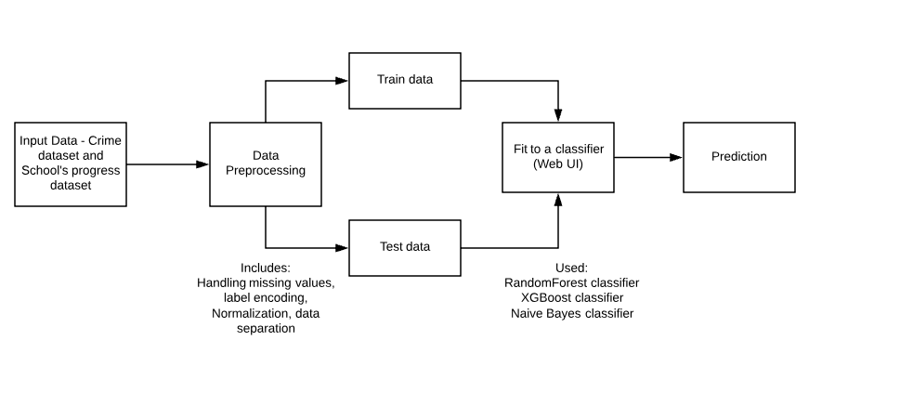
System design

Slide 7
Pre-processing of data
As the data sets were huge, the code to pre-process the data was run on the HPC
Crime data was clustered by considering the distance between each school and crime
Radius was taken as 3kms.
Crime data was filtered as per the above radius
L2 Normalization was performed
Crime Type – was assigned binary values

Slide 8
Classifiers used
The below classifiers were used
Random Forest Classifier
XGBoost Classifier
SGD Classifier
Naïve Bayes Classifier
GaussianMultinomialNB

Slide 9
results
The prediction using random forest classifier was more accurate than the SGD classifier.
The accuracies found were in par with the above results.
Accuracies were considerably low as the dataset had lot of missing values, and was imbalanced
Require more accurate school data, and crime data to arrive at better conclusions as to if there exists a dependency between them.

Slide 10
Thank - You

